Slide 1

PREDICTIVE MODELING FOR CAR INSURANCE CLAIM

Slide 2


BUSINESS PROBLEM STATEMENT
Develop a predictive model that assesses the claim probability for car insurance policies. The objective would be to understand the factors that influence claim frequency and severity in the period of six months and enable insurance companies to better assess risk and determine appropriate premiums for policyholders.

Slide 3
MACHINE LEARNING MODEL BUILDING STEPS
01
03
04
04
02
05
06
Data Collection for Machine Learning
Preprocessing and Preparing Your Data
Selecting the Right Machine Learning Model
Training Your Machine Learning Model
Evaluating Model Performance
Tuning & Optimizing Your Model

Slide 4
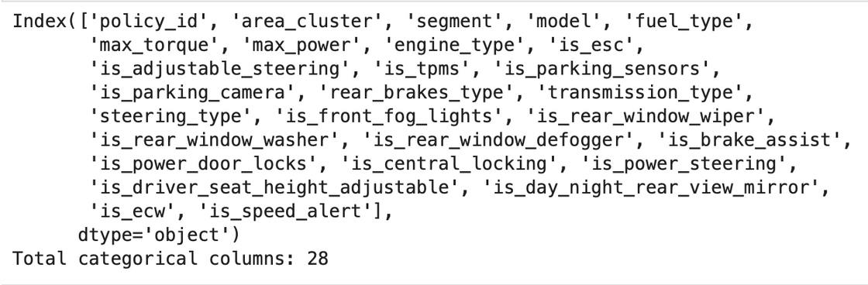
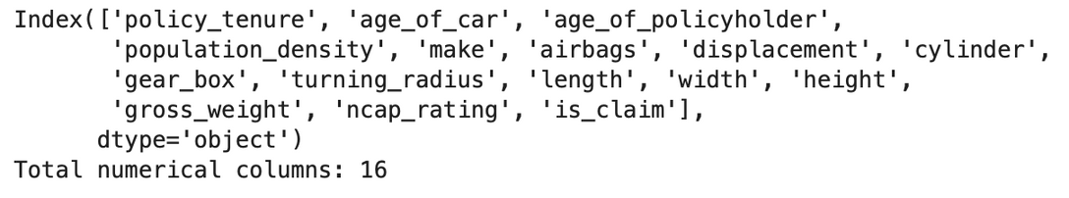
DETAILS ABOUT DATASET
Data Set contains 58592 rows & 44 columns. Out of which data types float - 4, int - 12, object - 28
CATEGORICAL COLUMNS
NUMERICAL COLUMNS
Dependent feature : is_claim

Slide 5
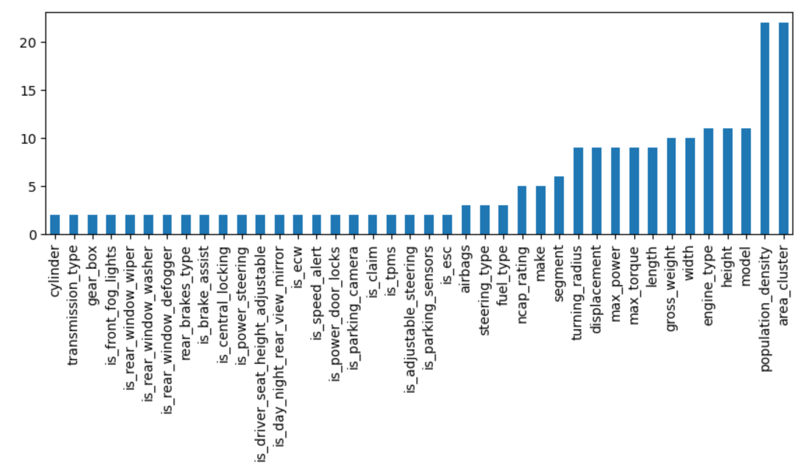
COUNTS OF UNIQUE VALUES IN EACH COLUMN

Slide 6
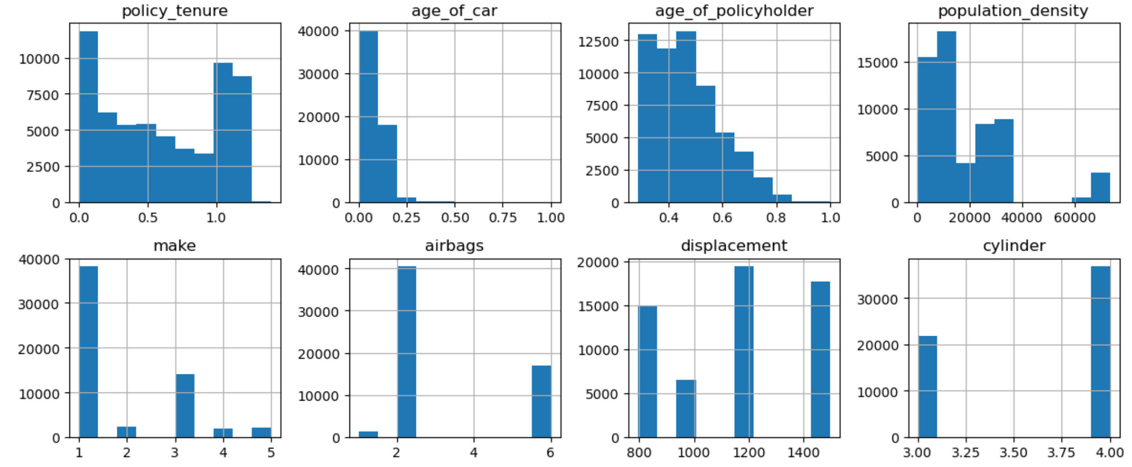
ANALYSIS OF EACH FEATURE
OBSERVATIONS:
Most people like almost 7000 have had their policy active for 0.1 years
Majority of the people opt for insurance immediately when they purchase the car
Most of the age of policy holders age is between 0.3 and 0.5
Most of the people PREFERRED make-1 cars followed by make-3 & least preferred are 2,4,5
Most of the people opt for 2 airbags (40k) followed by 6 airbags(17k) and least with 1 airbag (1200)
All the cars are having cylinders either 3 or 4

Slide 7
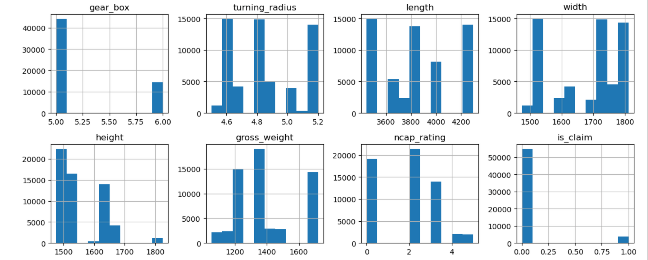
ANALYSIS OF EACH FEATURE
OBSERVATIONS:
Almost all the cars are having 5-6 gears in the gearbox
Most cars have ncap_rating as 2 followed by 0 and very few cars gave 4 (& above) as rating

Slide 8
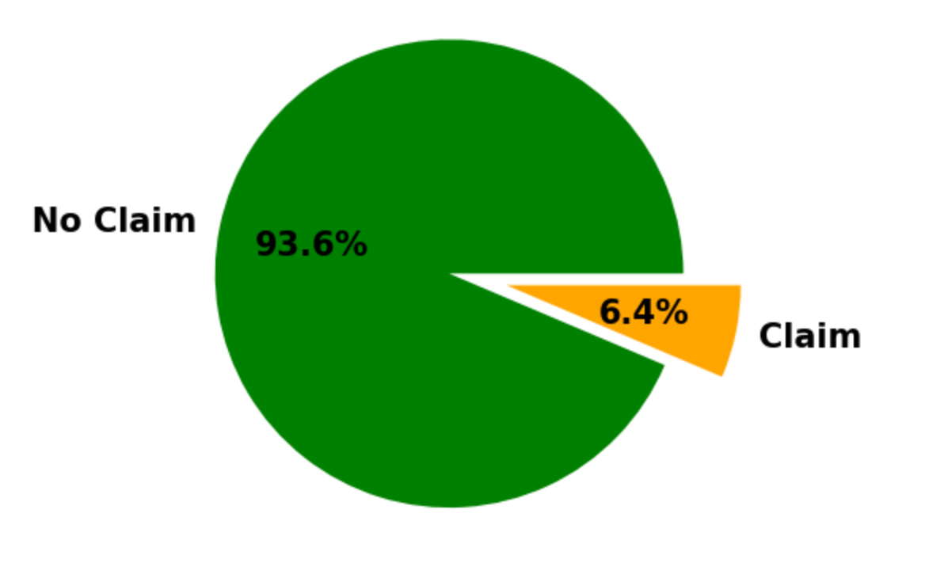
ANALYSIS OF DEPENDENT FEATURE
OBSERVATIONS:
IT'S HIGHLY IMBALANCED DATA. WE SHOULD DO IMBALANCE TREATMENT

Slide 9
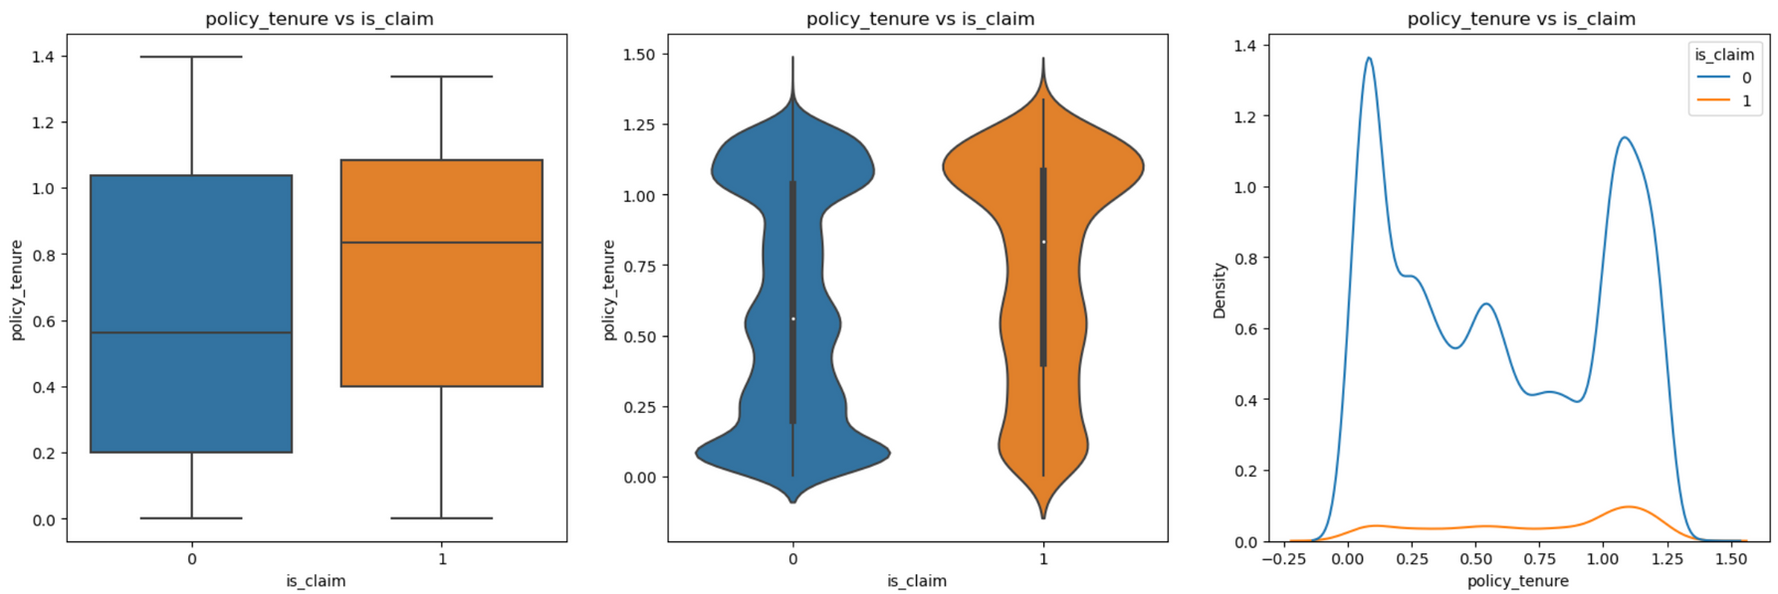
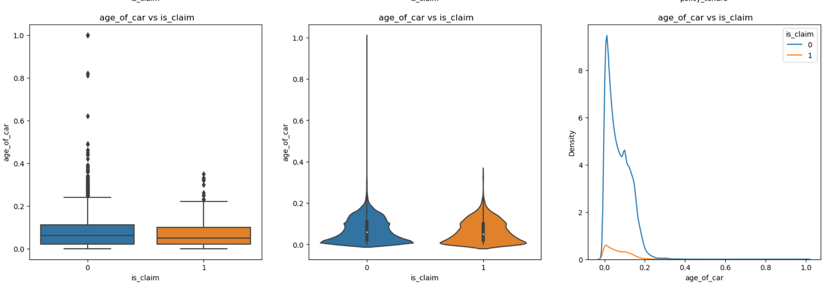
BIVARIATE ANALYSIS

Slide 10
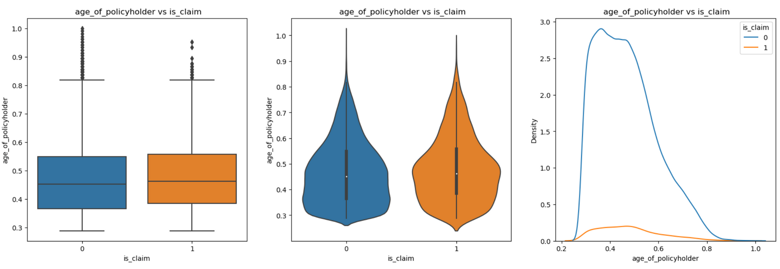
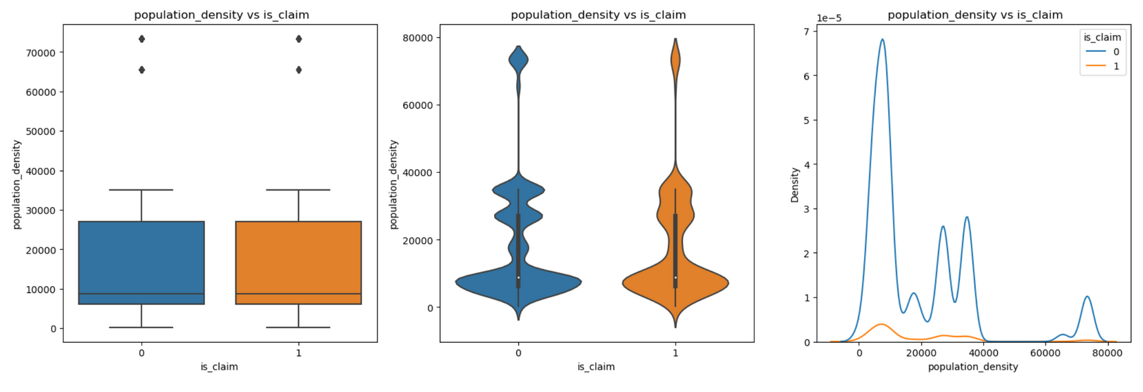
BIVARIATE ANALYSIS

Slide 11
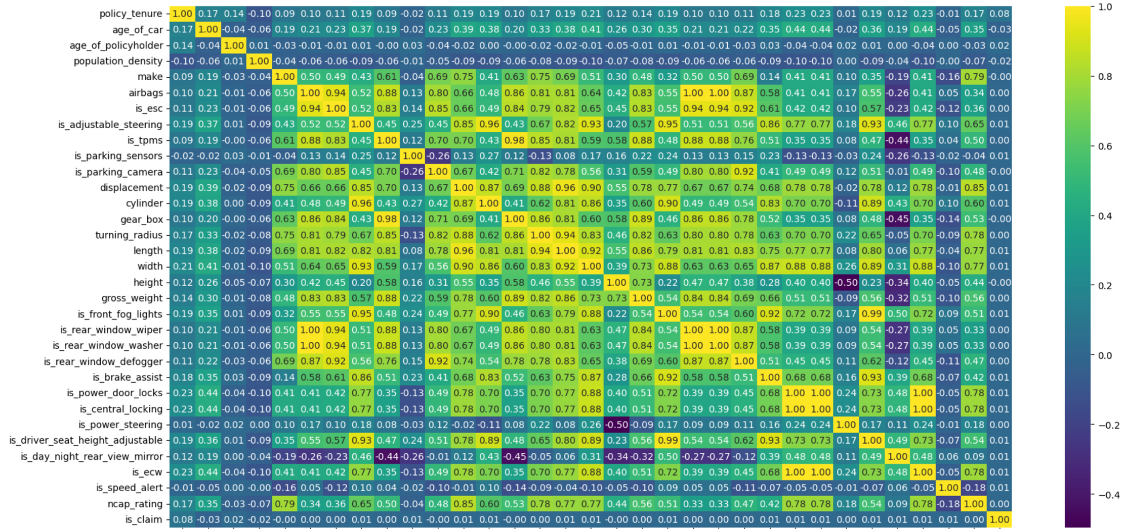
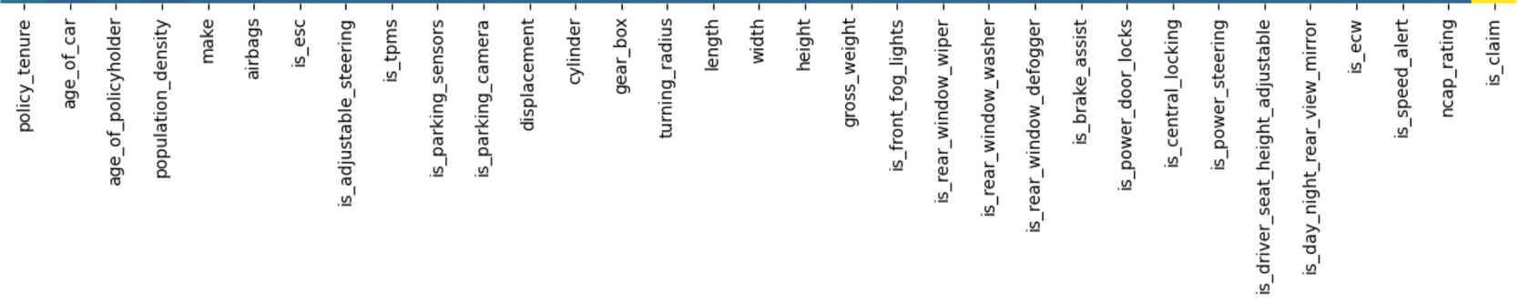
CORRELATION

Slide 12
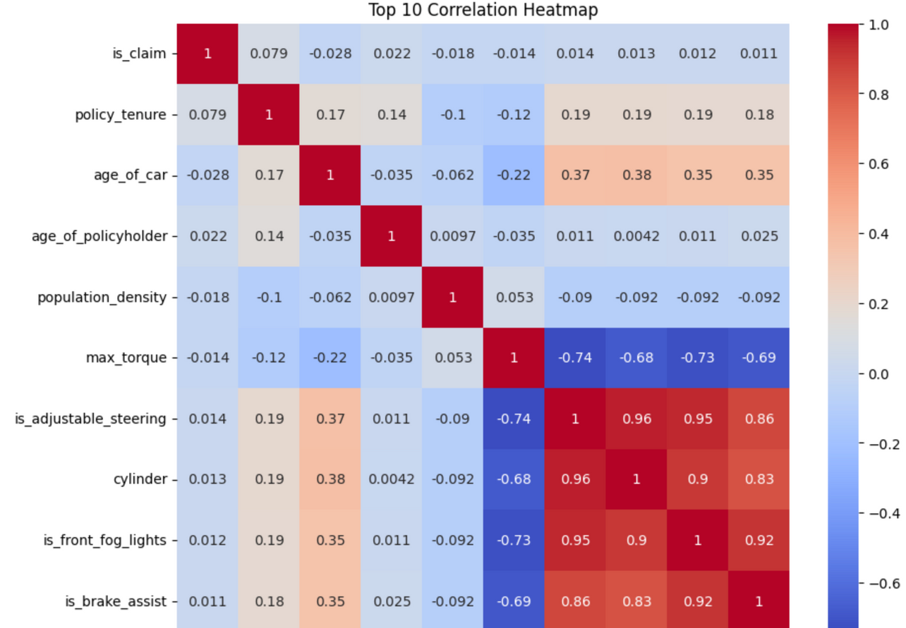
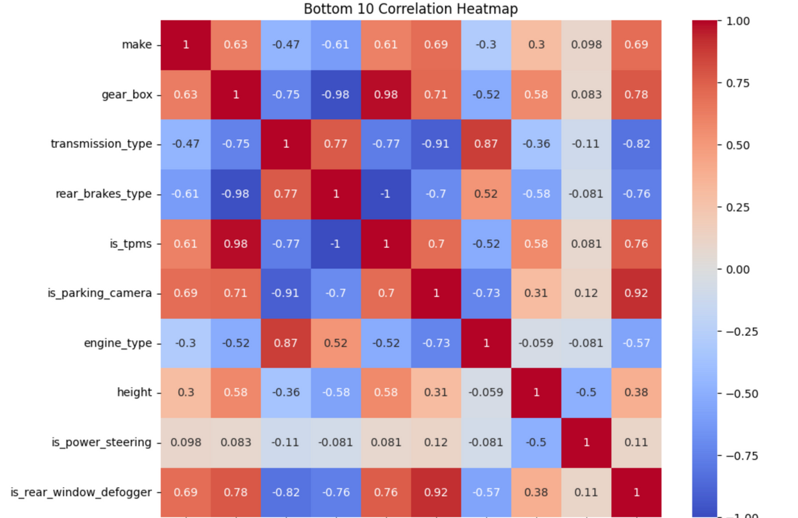
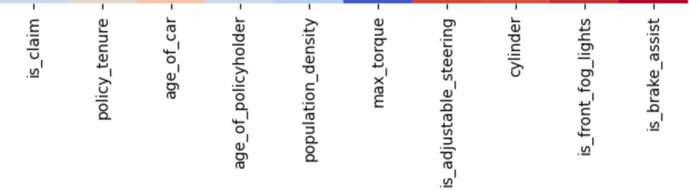
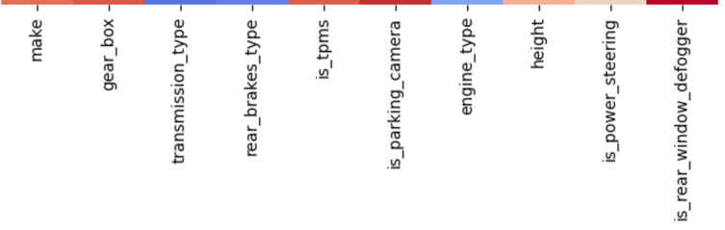

Slide 13
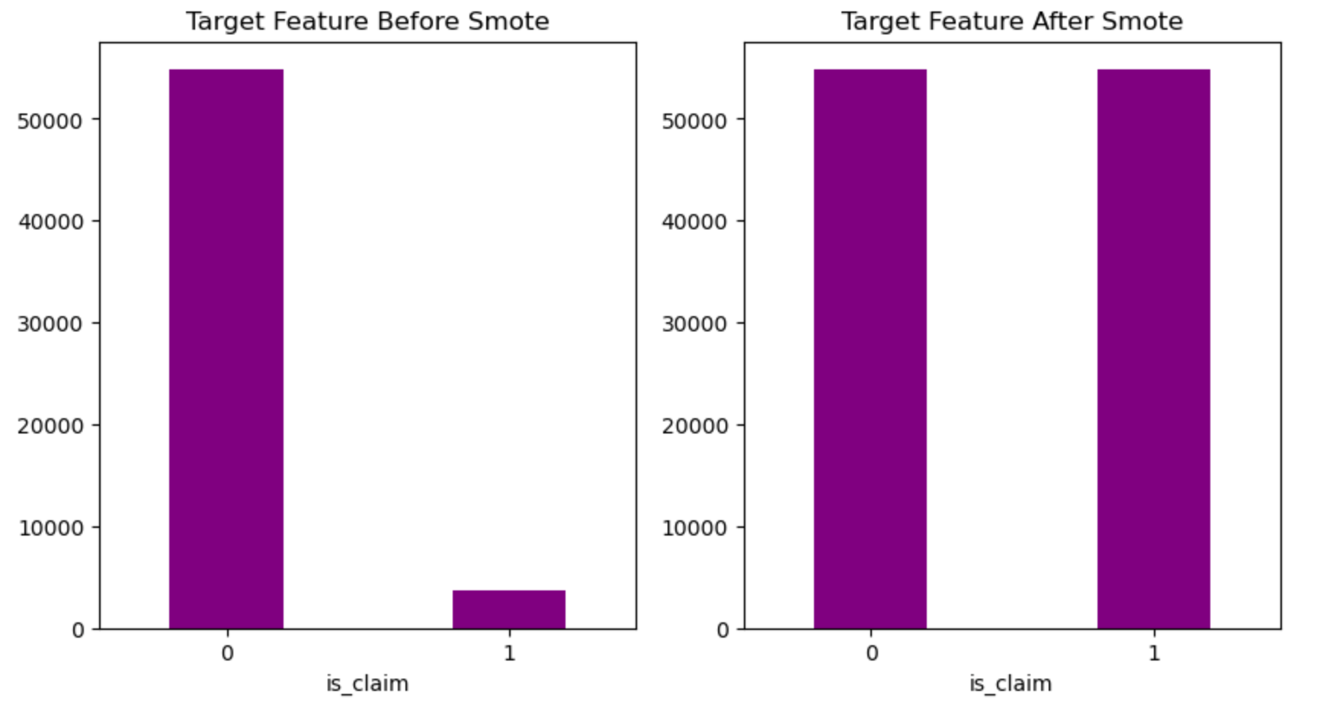
TARGET FEATURE AFTER IMBALANCE TREATMENT

Slide 14
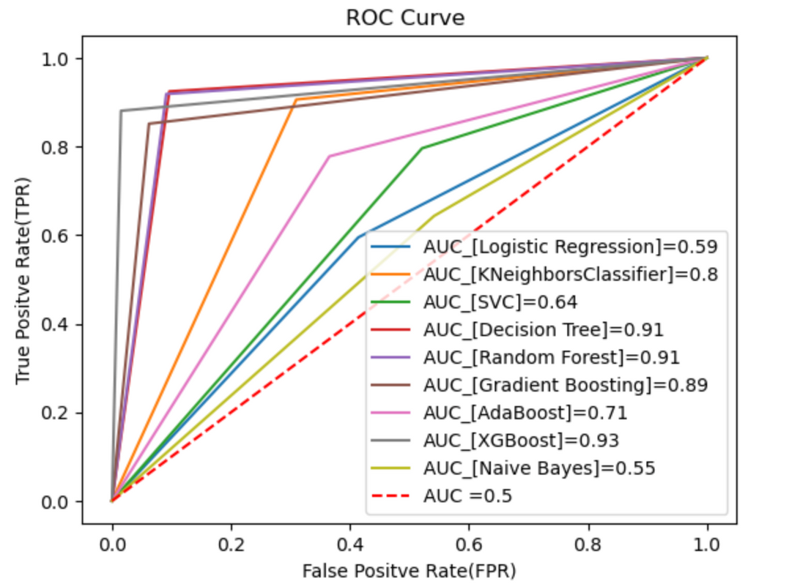
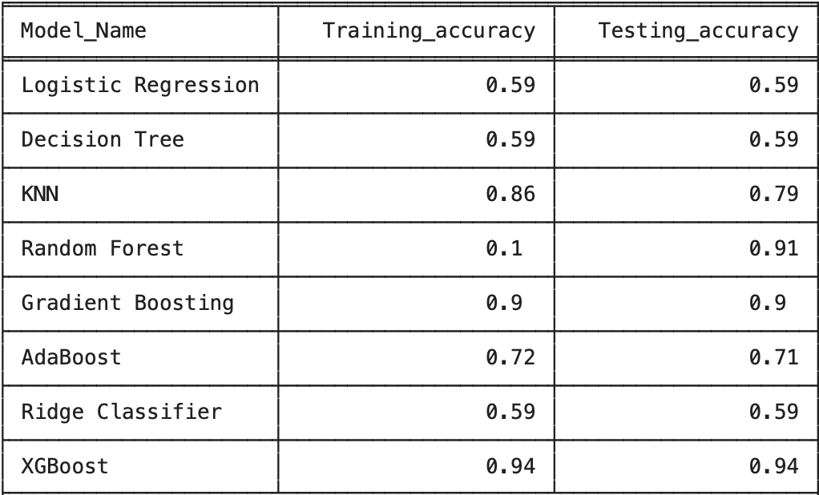
PERFORMANCE EVALUATION
TRAIN & TEST ACCURACY

Slide 15
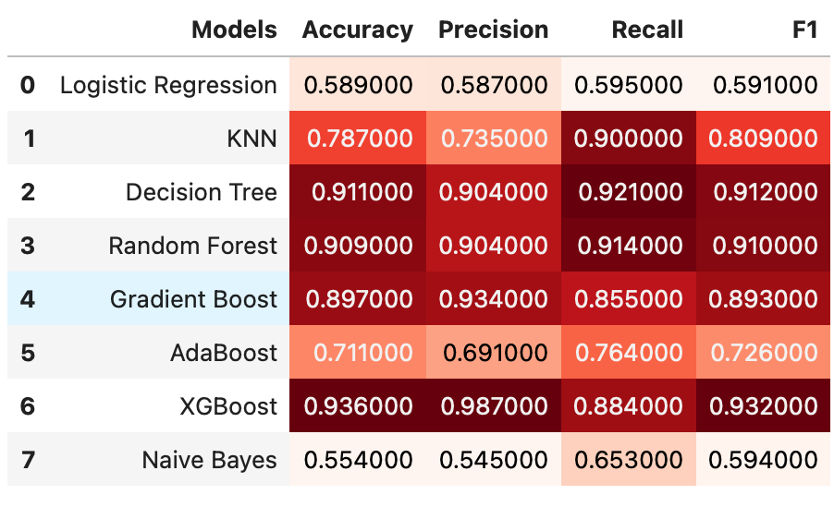
PERFORMANCE EVALUATION
After applying CV, the best performing models are Decision Tree, Random forest, Gradient boost, Xgboost
Hyper parameter tuning to be done on those best models

Slide 16
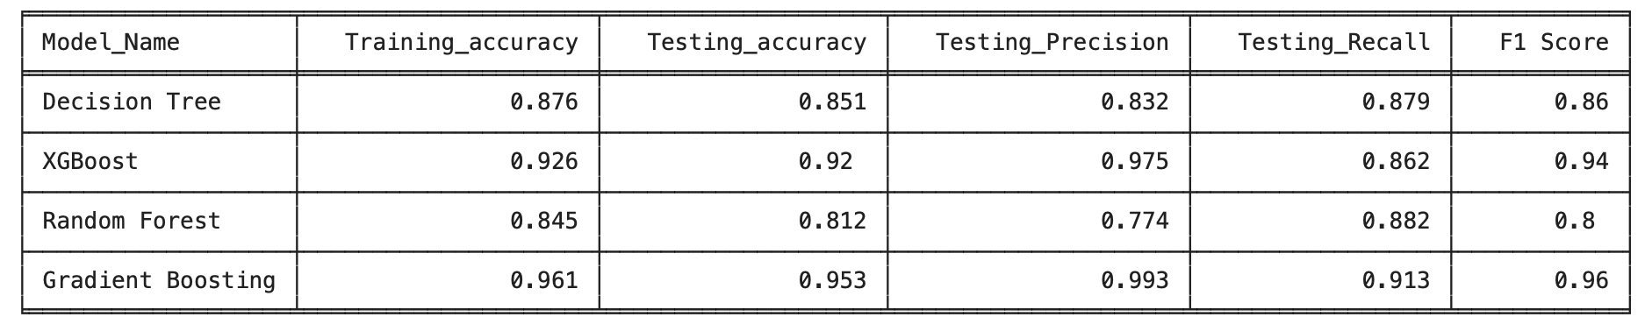
PERFORMANCE COMPARISION
With Gradient Boosting, the model has achieved the best results with an accuracy of 95%, Precision of 99% which means that my model is very good at correctly identifying positive instances (true positives) out of all instances that it predicted as positive which is very important aspect for risk management for the insurance company

Slide 17
THANK YOU

